Slide 1
Metric System
Scientific Measurements

Slide 2
Metric System
Developed by the French in the late 1700’s.
Based on powers of ten, so it is very easy to use.
Used by almost every country in the world, with the notable exception of the USA.
Especially used by scientists.
Abbreviated SI, which is French for Systeme International.

Slide 3
Metric Prefixes
Regardless of the unit, the entire metric system uses the same prefixes.
Common prefixes are:
kilo = 1000
centi = 1/100th
milli = 1/1000th
1 meter = 100 centimeters= 1000 millimeters

Slide 4
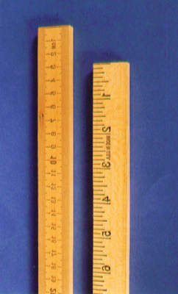
Length
Length is the distance between two points.
The SI base unit for length is the meter.
We use rulers or meter sticks to find the length of objects.

Slide 5
Mass
Mass is the amount of matter that makes up an object.
A golf ball and a ping pong ball are the same size, but the golf ball has a lot more matter in it. So the golf ball will have more mass.
The SI unit for mass is the gram.
A paper clip has a mass of about one gram.
The mass of an object will not change unless we add or subtract matter from it.

Slide 6
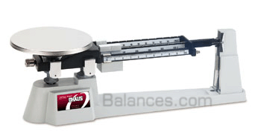
Measuring Mass
We will use a triple beam balance scale to measure mass.
Gravity pulls equally on both sides of a balance scale, so you will get the same mass no matter what planet you are on.

Slide 7
Weight
Weight is a measure of the force of gravity on an object.
Your weight can change depending on the force of gravity. The gravity will change depending on the planet you are on.
The SI unit for weight is the Newton (N).
The English unit for weight is the pound.

Slide 8
Gravity
Gravity is the force of attraction between any two objects with mass.
The force depends on two things:
more distance = less gravity = less weight
less distance = more gravity = more weight
more mass = more gravity = more weight
less mass = less gravity = less weight

Slide 9
Weight and Mass
Jill | Earth 1 gravity | Moon 1/6th gravity | Jupiter 2.5 gravities | On orbit 0 gravity
mass | 30kg | 30kg | 30kg | 30kg
weight | 300N | 50N | 750N | 0 Newtons
Notice that Jill’s mass never changes. Her mother will not allow us to take parts off her, or add parts to her, so her mass stays the same. Jill is 30kg of little girl no matter where she goes!

Slide 10
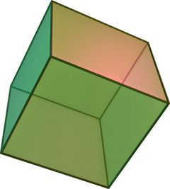
Volume
Volume is the amount of space contained in an object.
We can find the volume of box shapes by the formula Volume = length x width x height
In this case the units would be cubic centimeters (cm³).
So a box 2 cm x 3 cm x 5cm would have a volume of 30 cm³
V = L x W x H

Slide 11
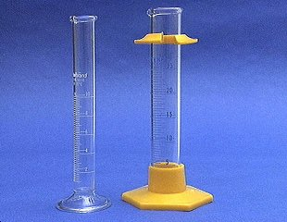
Base Units
The base unit for volume is the Liter.
We measure volume with a graduated cylinder.

Slide 12
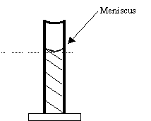
Graduated Cylinders
Liquids form curved, upper surfaces when poured into graduated cylinders
To correctly read the volume, read the bottom of the curve called the meniscus

Slide 13
Liquid Volume
When the metric system was created, they decided that 1 cm³ of water would equal 1 milliliter of water and the 1 mL of water will have a mass of one gram.
1cm³ water =1 ml of water = 1 gram

Slide 14
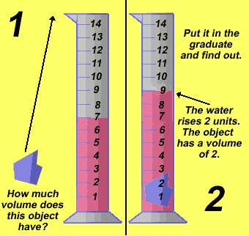
Water Displacement
We can use water displacement to find the volume of objects that are not boxed shaped.
We can put water in a graduated cylinder. If a rock causes the level to rise from 7 to 9 ml, the the rock must have a volume of 2-mL.

Slide 15
Water Mass and Volume
1 cm³ water = 1 mL of water = 1 gram
So what would be the mass of 50 mL of water be?
50 grams
So what would be the mass of 1 liter of water be?
1 L = 1000 mL so its mass would be 1000 grams or a kilogram.

Slide 16
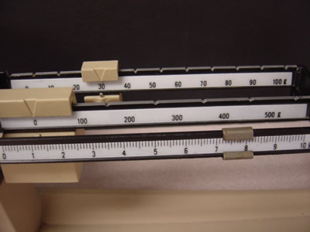
Density
Density is the amount of matter (mass) compared to the amount of space (volume) the object occupies.
We will measure mass in grams and
volume in ml or cm³

Slide 17
Density Formula
Density is mass divided by volume.
Density = mass/volume
Remember, all fractions are division problems.
Since the unit for mass is grams, and the unit for volume is ml or cm³, then the unit for density is g/ml, or g/ cm³

