Slide 1
Composting Basics

Slide 2
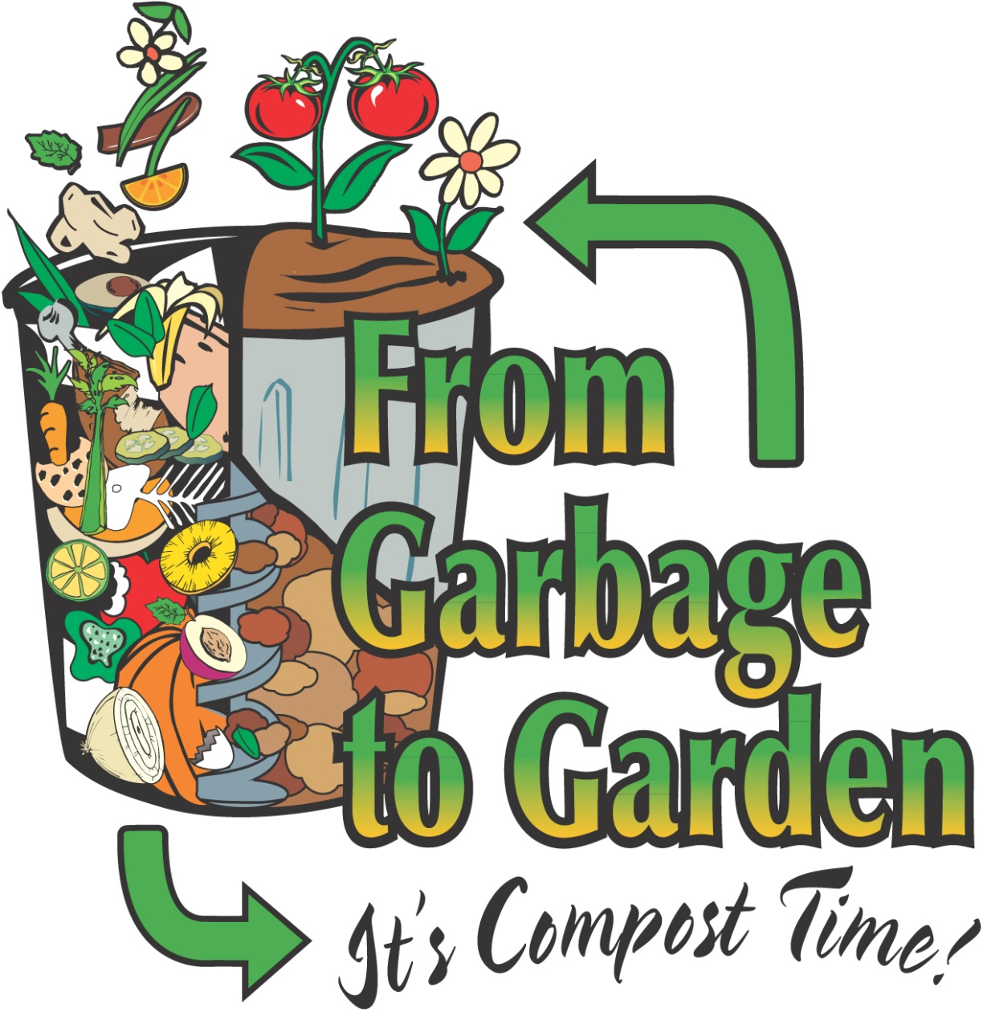

Slide 3
What is composting and compost?
Composting is a natural process. Organic materials such as leaves, grass, and vegetable scraps are broken down by microorganisms, forming a rich soil-like substance called compost or humus.
Compost is partially decomposed organic matter
Humus is completely decomposed organic material

Slide 4
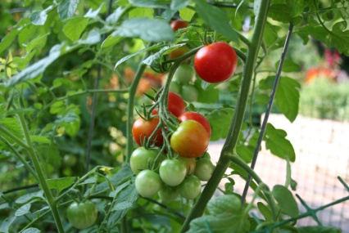
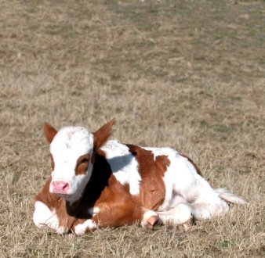
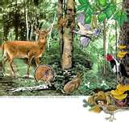
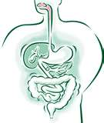
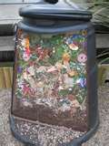
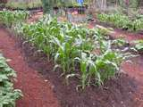
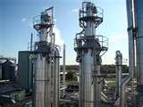
How does this relate to the cycling of matter?
Energy from the sun
Grows Biomass
Waste from Biomass
Nutrients returned to the soil
digestion, compost, energy

Slide 5
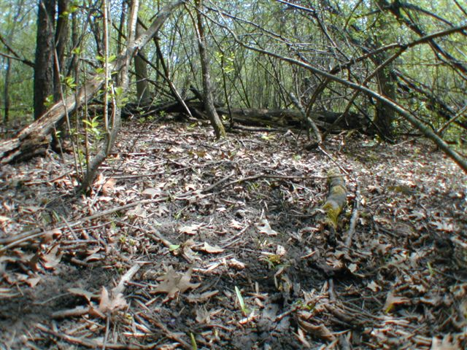
Uses of Compost
Mulch
Fertilizer
Mixed in soil & potting mix
Composting happens naturally on the forest floor, feeding plants and trees through nutrient rich soil.

Slide 6
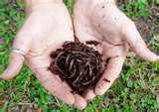
High Carbon
“Browns”
High Nitrogen
“Greens”
Composting
Organisms
Water - Moist
Air – helps prevent
unpleasant odors from decomposition without oxygen
Temperature
“Warm”
Keys to a successful Compost Bin

Slide 7
Why Should we Compost?
Good for the planet, reduce waste to landfills
Returns important nutrients to ecosystem
Grow healthier, larger plants & vegetables
Saves money, don’t have to buy mulch & fertilizer
Easy & Convenient

