Slide 1
Catastrophic Events
Predict and Describe their impact on Ecosystems

Slide 2
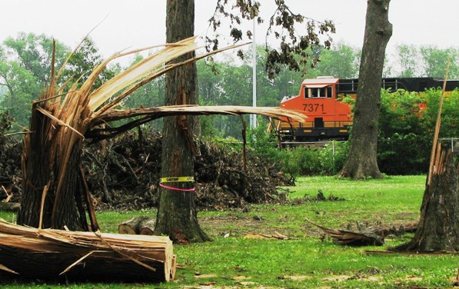
Tornado
Violently rotating column of air with wind speeds from 40-318 mph
Impact on Ecosystem
Destroys habitat, Vegetation, and kills animals
Surviving Animals will move away from the area in search of food and shelter
Recovery could take years

Slide 3
Hurricane
A tropical cyclone with wind speeds from 74 to 249 MPH
Impact to Ecosystem
Massive fish kills from Fresh/saltwater invasion and pollution
Beach Erosion, loss of habitat for oyster beds and coral reefs
Animals moved or killed
Recovery takes decades – an area may never recover

Slide 4
Floods
A rising body of water that submerges normally dry land
Impact on Ecosystem
Damage to habitat – organisms die
Pollution from chemicals and sewage
Introduction of invasive species
Sediment and nutrients brought to farmlands
Recovery – Weeks to MOnths

